Slide 1
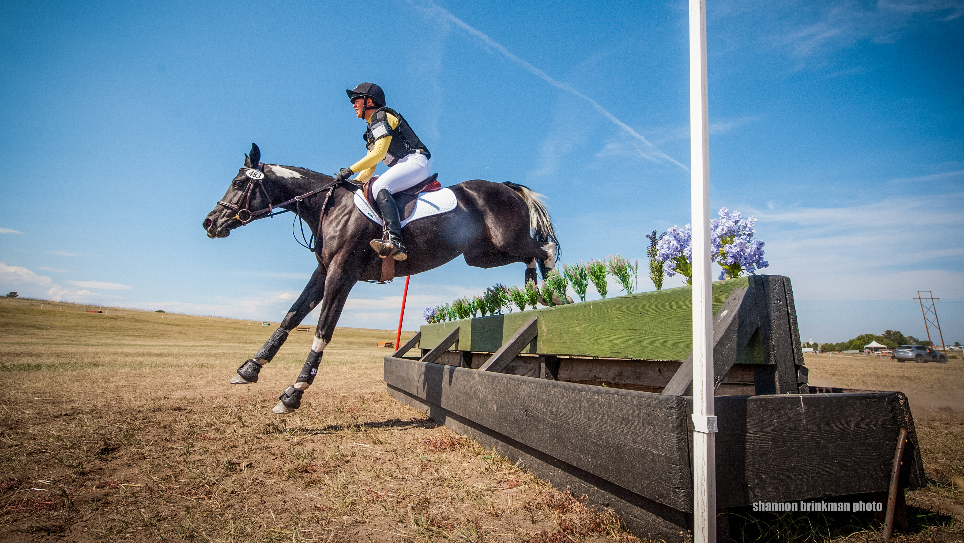
Predicting 3 Day Eventing Scores
Jacquie Schoeggl
Regis University
MSDS 692

Slide 2



What is 3 Day Eventing?
Originates from cavalry tests
"Equestrian Triathlon"

Slide 3
Shows horse's training and submission
Each movement is given a score 0-10, and the total points are calculated into a percentage
That percentage is subtracted from 100 to obtain a penalty score
Example: Jane and her horse score 98 out of 150 points.
98/150 = 0.653.
0.653 * 100 = 65.3
100 – 65.3 = 34.7 penalty points

Slide 4
Shows horse's bravery and stamina over a course of varied terrain and obstacles
Refusals or disobediences are penalized with 20 penalty points
If a horse and rider go over the optimum time, penalties are also added
Example: Jane and her horse scored 34.7 in dressage and had 1 refusal on cross country. They add 20 penalty points to their score for a total of 54.7

Slide 5
Shows horse's stamina and recovery after a hard day of cross country
Refusals or disobediences are penalized with 4 penalty points
The fall of a rail also results in 4 penalty points
If a horse and rider go over the optimum time, penalties are also added
Example: Jane and her horse have a total of 54.7 penalties. They knock down 2 rails, adding 8 penalty points to their score. Jane and her horse finish on 62.7 penalties

Slide 6
What are the different divisions?
Rider (R)
The horse cannot have completed an event above the next highest level
Amateur(A)
Competitors do not accept enumeration for riding or training horses
Junior (J)
Competitors under age 18
Youth (Y)
Master(M)
Competitors under age 14
Competitors over age 40
Horse (H)
Competitors who have not completed an event above the next highest level in the last five years

Slide 7
Project Plan/Overview
Is there a difference in scores between different divisions?
If so, which divisions are more competitive (I.e. lower scores)?
Are competitors from a certain division more likely to fall or be eliminated?
Is there a difference in scores from year to year?
Can the final score of a competitor be estimated given an initial dressage score and a division?
Can the probability of elimination be given based on Division and initial dressage score?

Slide 8
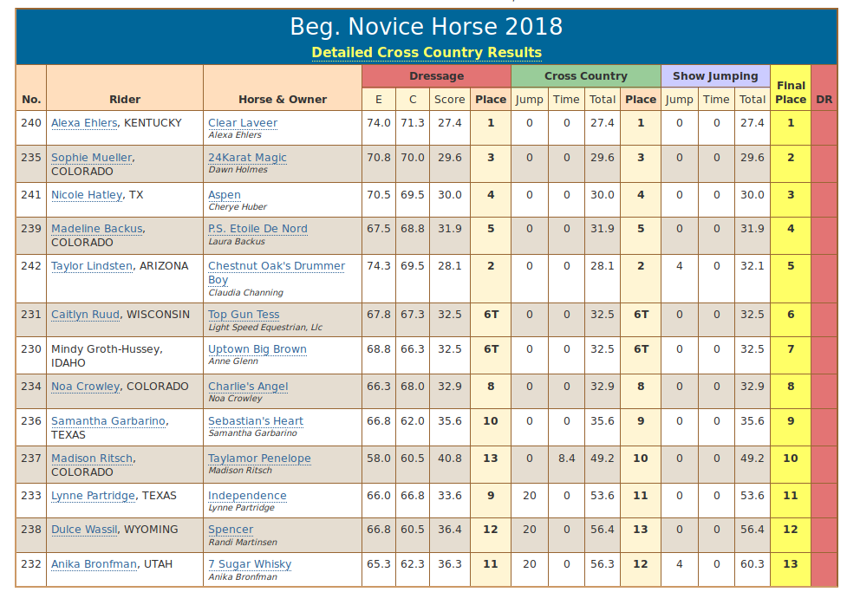
The Data
Data were collected from http://livescore.useventing.com/
collected data from 6 divisions over 3 years (2016-2018)
Rider, Horse and Owner names were removed as well as specific dressage scores
Year and Division were added as columns

Slide 9
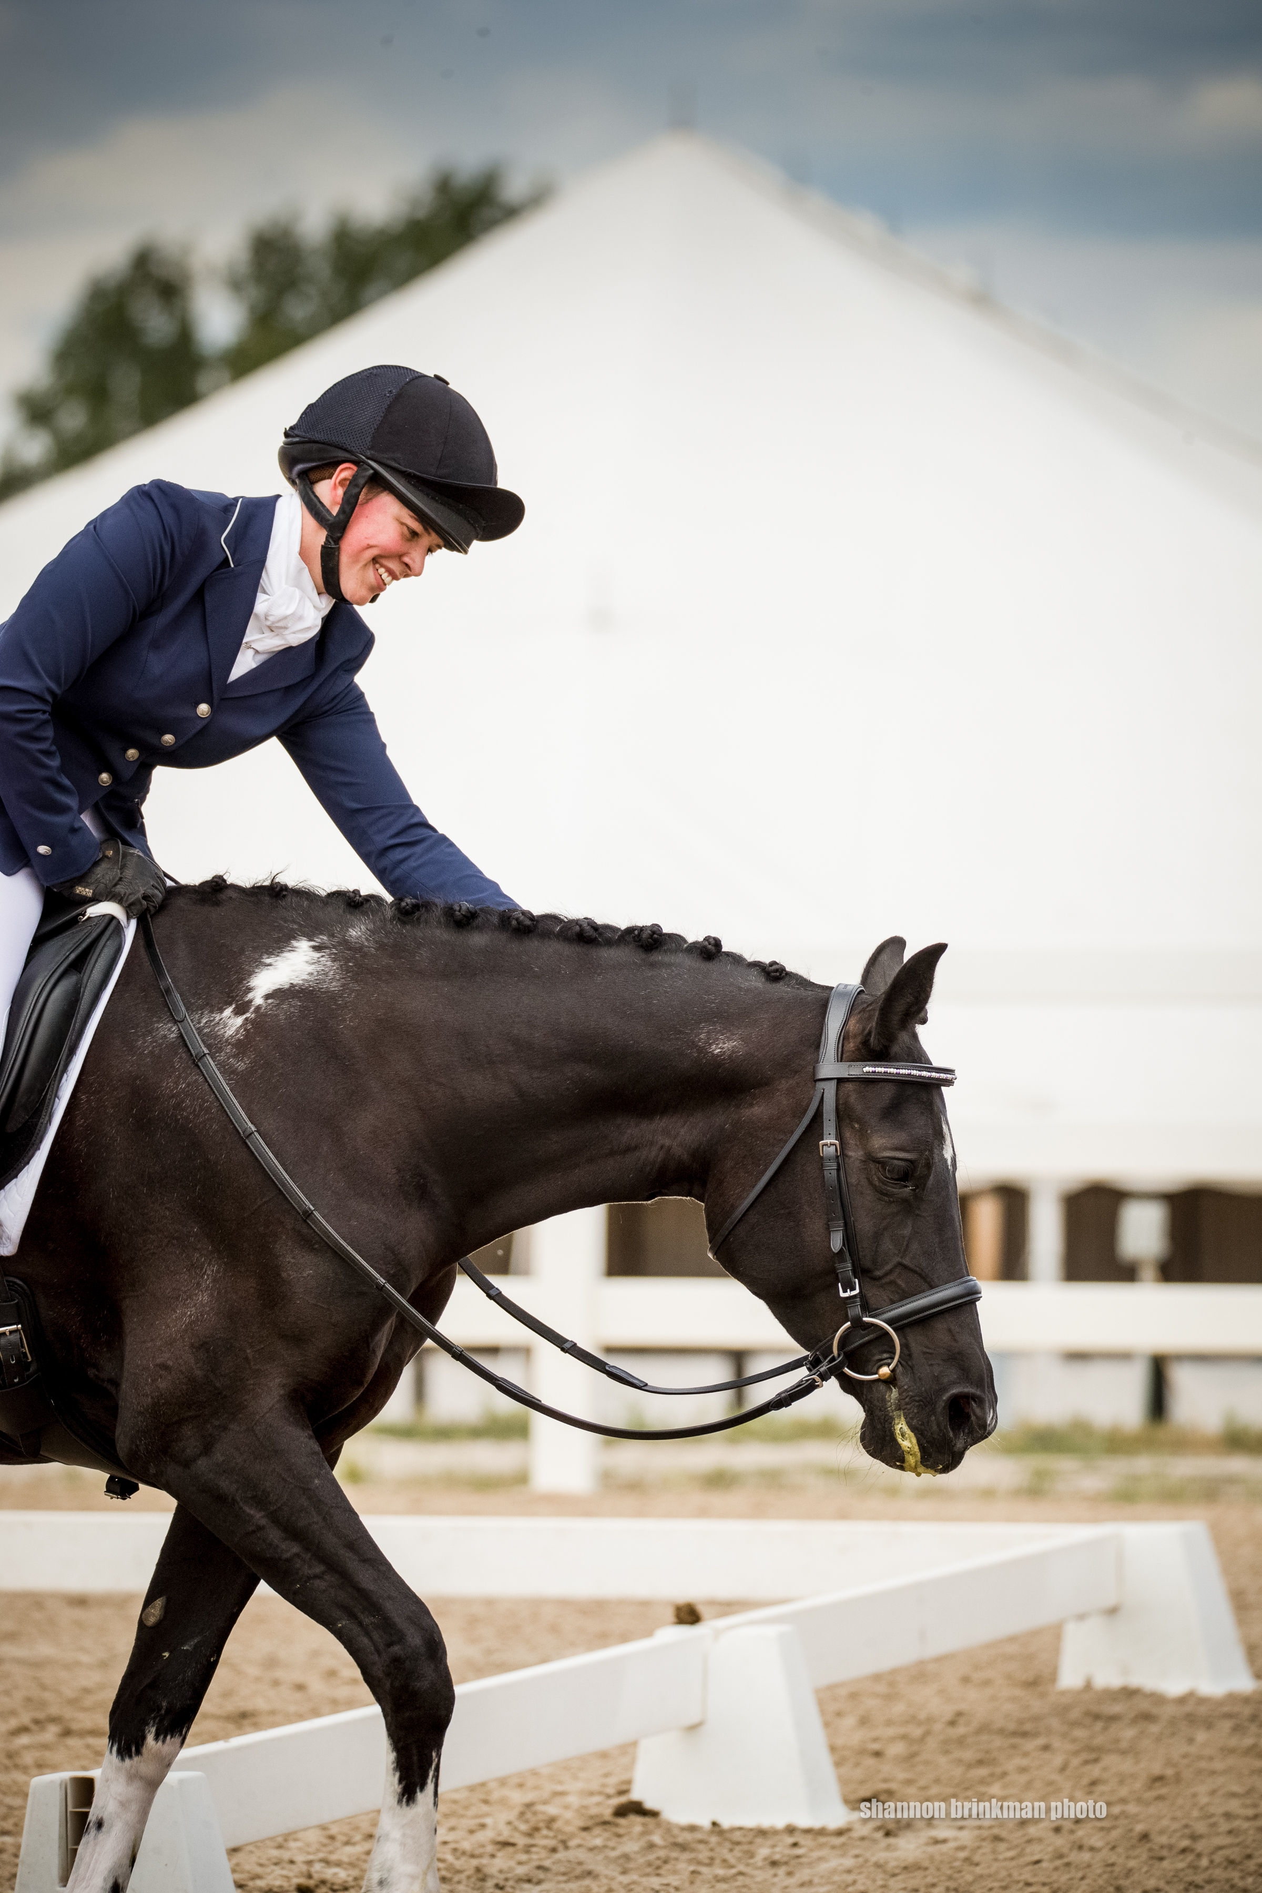
Exploratory Data Analysis
422
Total number of competitors who completed the event
43
Percentage of competitors who finished on their dressage score
19.8
Lowest score
271
Number of competitors who moved up in placing

Slide 10
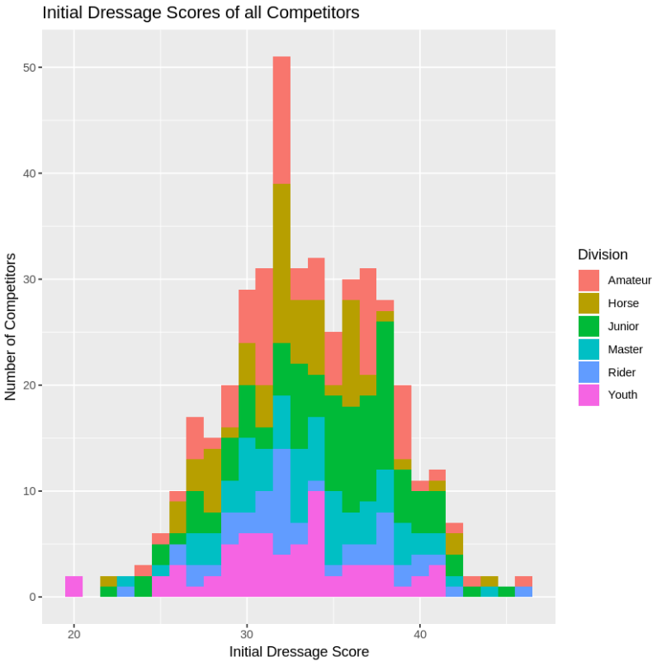
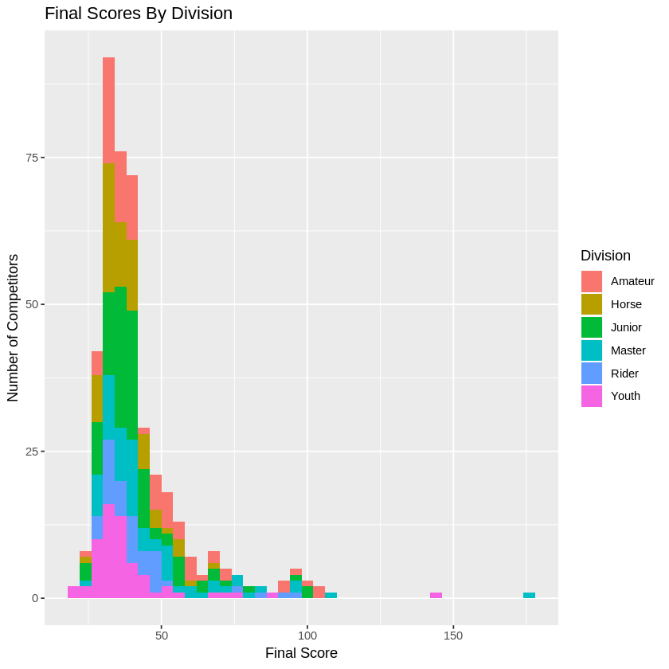

Slide 11
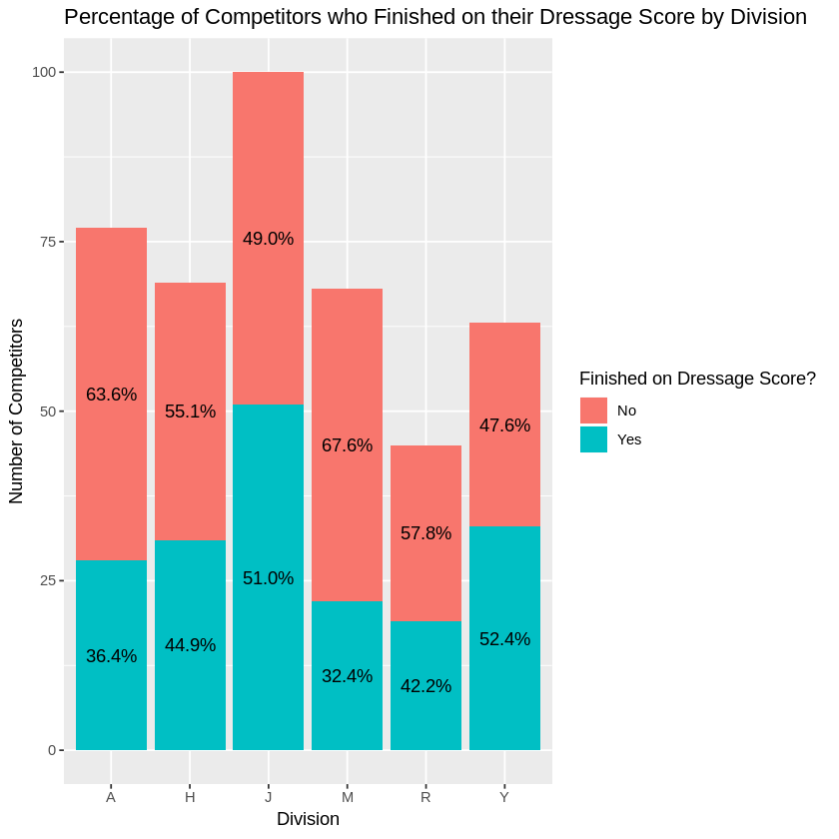
Feature Engineering
Use the difference between initial Dressage Score and Total after Show Jumping to calculate the percentage of competitiors who finished on their dressage score

Slide 12
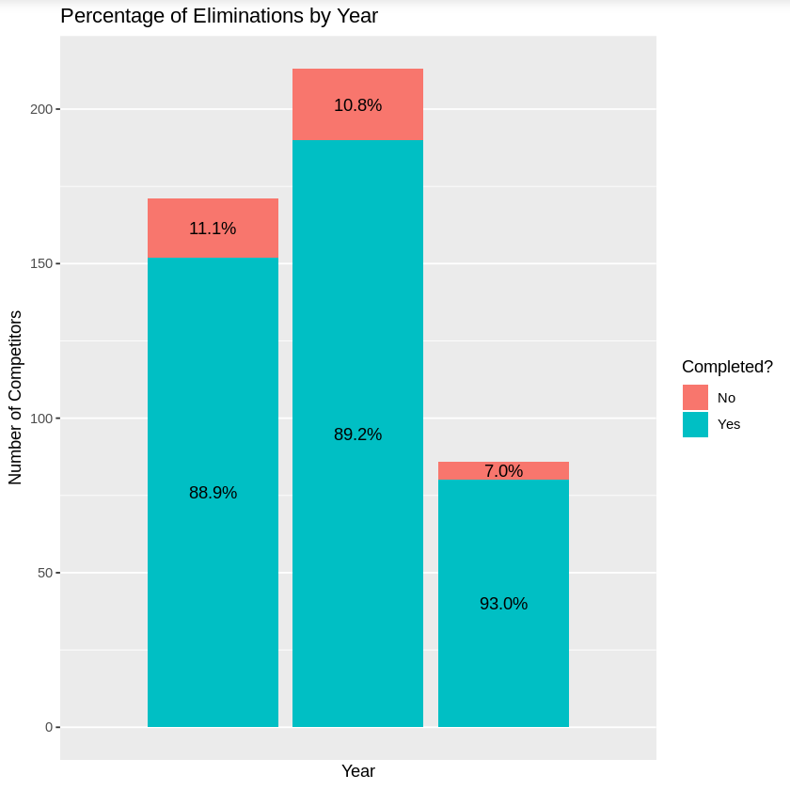
Exploratory Data Analysis Continued: Incompleted Scores

Slide 13
Machine Learning
Supervised
Regression
Linear Model

Slide 14
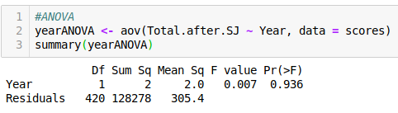
Linear Regression
H0: There is no difference in the final score between years
HA: There is a difference in the final scores between years

Slide 15
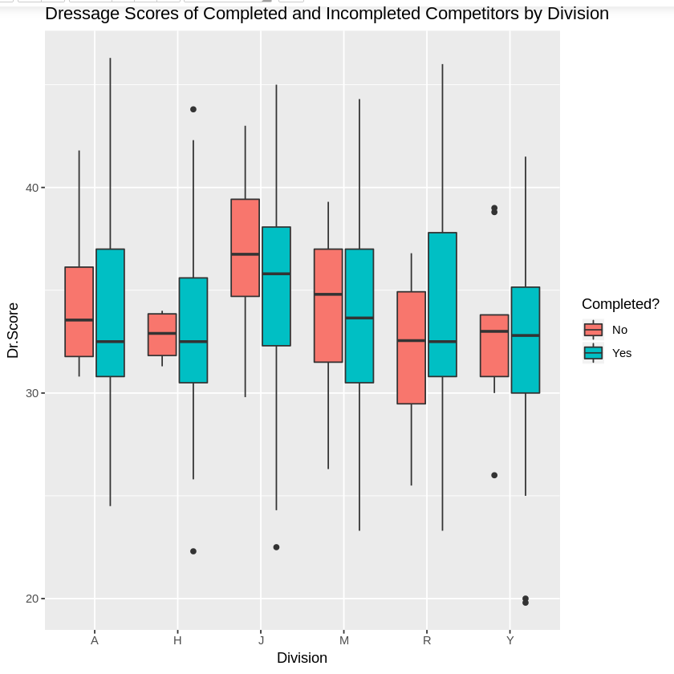
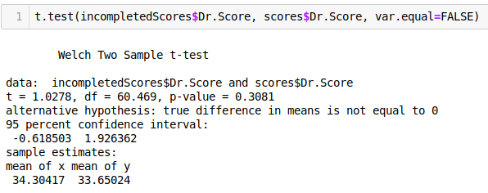
Linear Regression
H0: There is no difference in the initial dressage score for competitors who were eliminated and those that were not.
HA: There is a difference in the initial dressage score for competitors who were eliminated and those that were not.

Slide 16
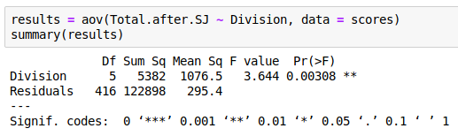
Linear Regression
H0: There is no difference in the final score between divisions
HA: There is a difference between final scores in divisions

Slide 17
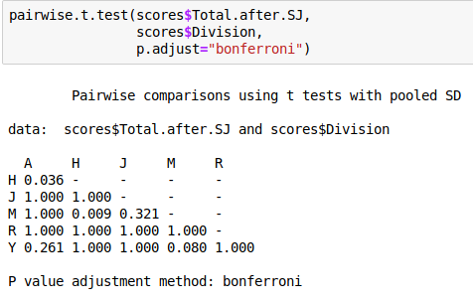
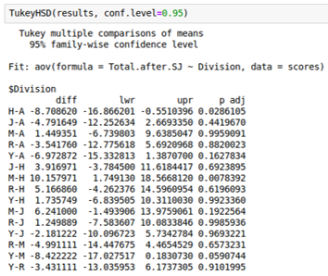
Post hoc Testing

Slide 18
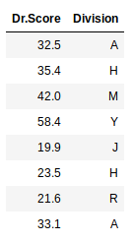
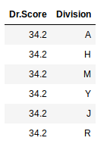
Now for the Fun Part: Prediction!

Slide 19
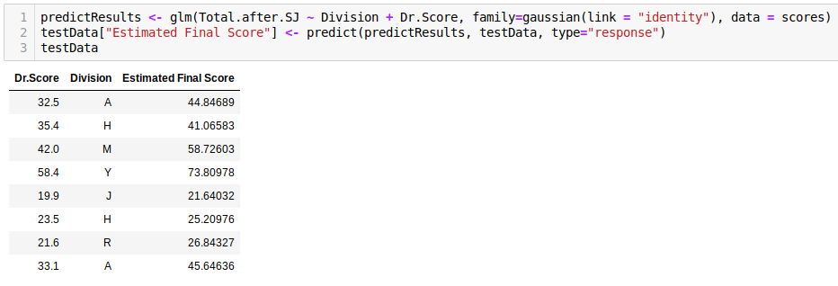
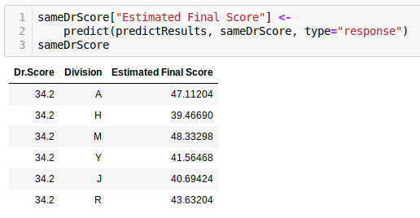

Slide 20
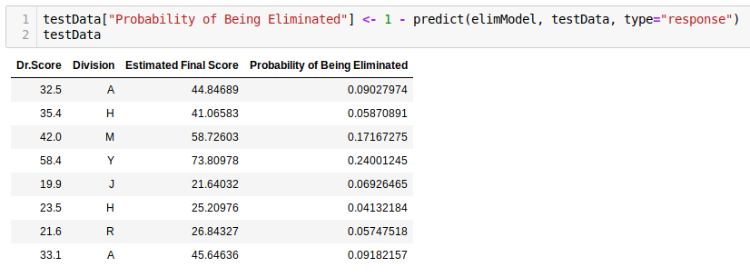
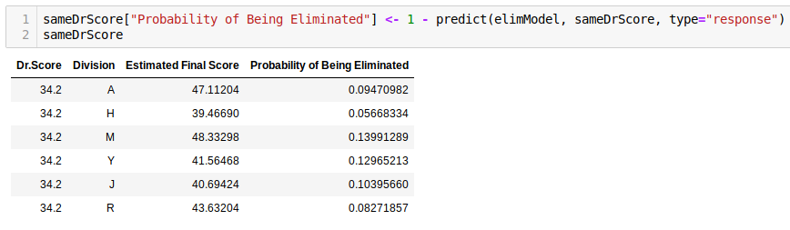

Slide 21
Thank you

